Slide 1

Neural Substrates of Attention and Awareness
Dan Birman
Gardner Lab
Lightning Talks – 2015-04-23
Notes:
This project starts with a question: "Do we need to be attending to something to see it?" And I think that is an interesting question, but also a bad question because the answer is both yes & no. Let me show you what you mean.

Slide 2
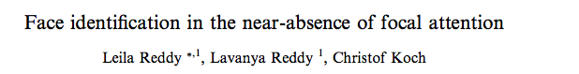


Notes:
Here is a classic task: you’re attending to these characters looking to see if there is an L among the Ts and a face flashes in the periphery. Most of the people in this room will have identified the gender of the face from that brief unexpected presentation

Slide 3
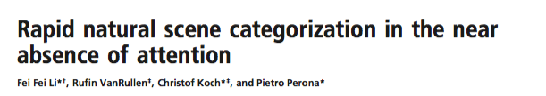
Notes:
Here again, same task, this time most of the people in the audience will have noticed that the scene was a city. So here were two examples of the “No” answer: you didn’t direct attention to a feature, but were nevertheless aware of its properties.

Slide 4

Notes:
Let’s try a different examlpe now. I want you to pay attention to motion and count the planes as they cross the screen.

Slide 5

Notes:
Ready? Here we go.
Now, you were directing your attention at motion, and in the background you were unaware of several changes that happened. Let me highlight them and then switch back to the original image.

Slide 7
Notes:
So we have a conundrum, in some situations attention seems to be essential and in others its unnecessary! But I think there’s a solution here: we have to understand that attention is not a single process. Even though we intuitively we feel like attention is always the same, its implementation in the brain changes depending on the situation and the attended feature.

Slide 8
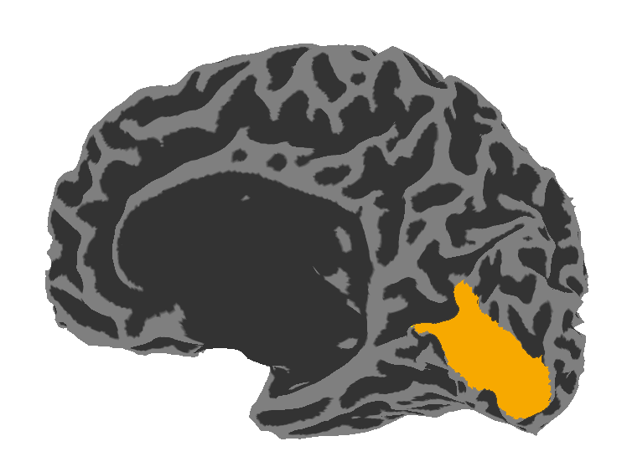
Visual Area V1:
Sensitive to Contrast
Notes:
Take contrast for example, we know that contrast is represented by neurons the first cortical visual area: V1, and we know that V1 is sufficient to account for most of our perception of contrast. We also know that attention to contrast causes very specific changes in V1.

Slide 9
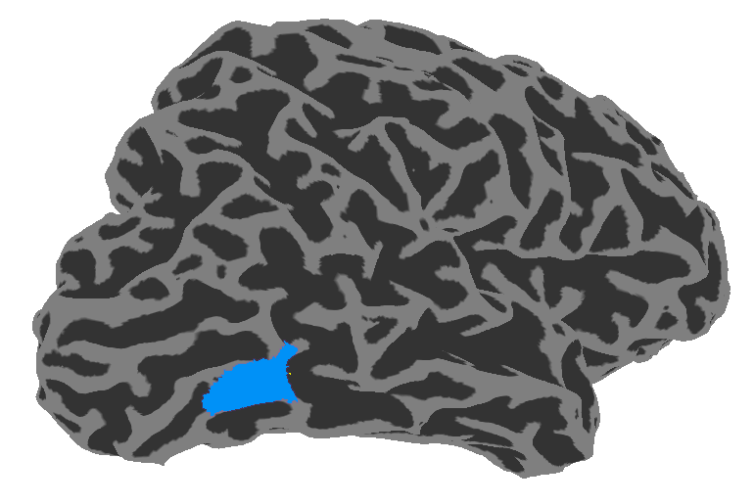
Visual Area V1:
Sensitive to Contrast
Visual Area hMT:
Sensitive to Motion Coherence
Notes:
In a similar way, responses in area MT account for most of our perception of motion and attention to motion affects MT responses.
So to study attention as a neural process we created a simple task pitting these two areas against each other.

Slide 10
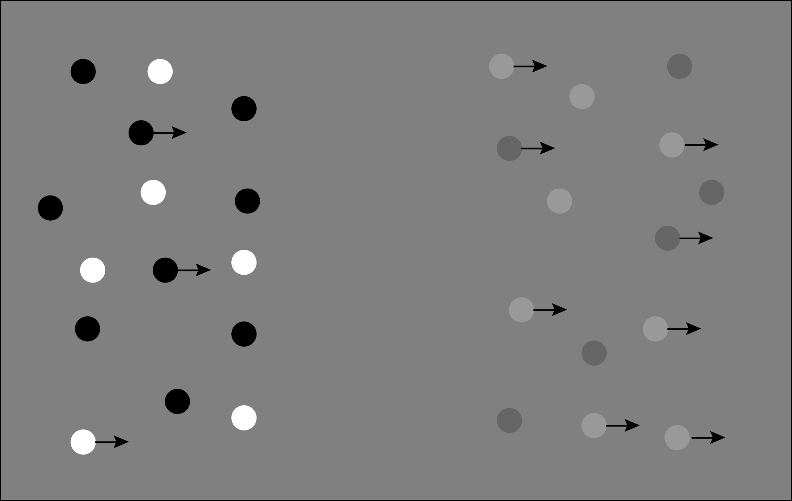
Notes:
In our task you would see two dot patches like these, and be asked to either identify which side has more intense contrast, or which side has more intense motion (left and right, respectively). Ahead of time we would either cue you to attend to motion or contrast. So what happens?

Slide 11
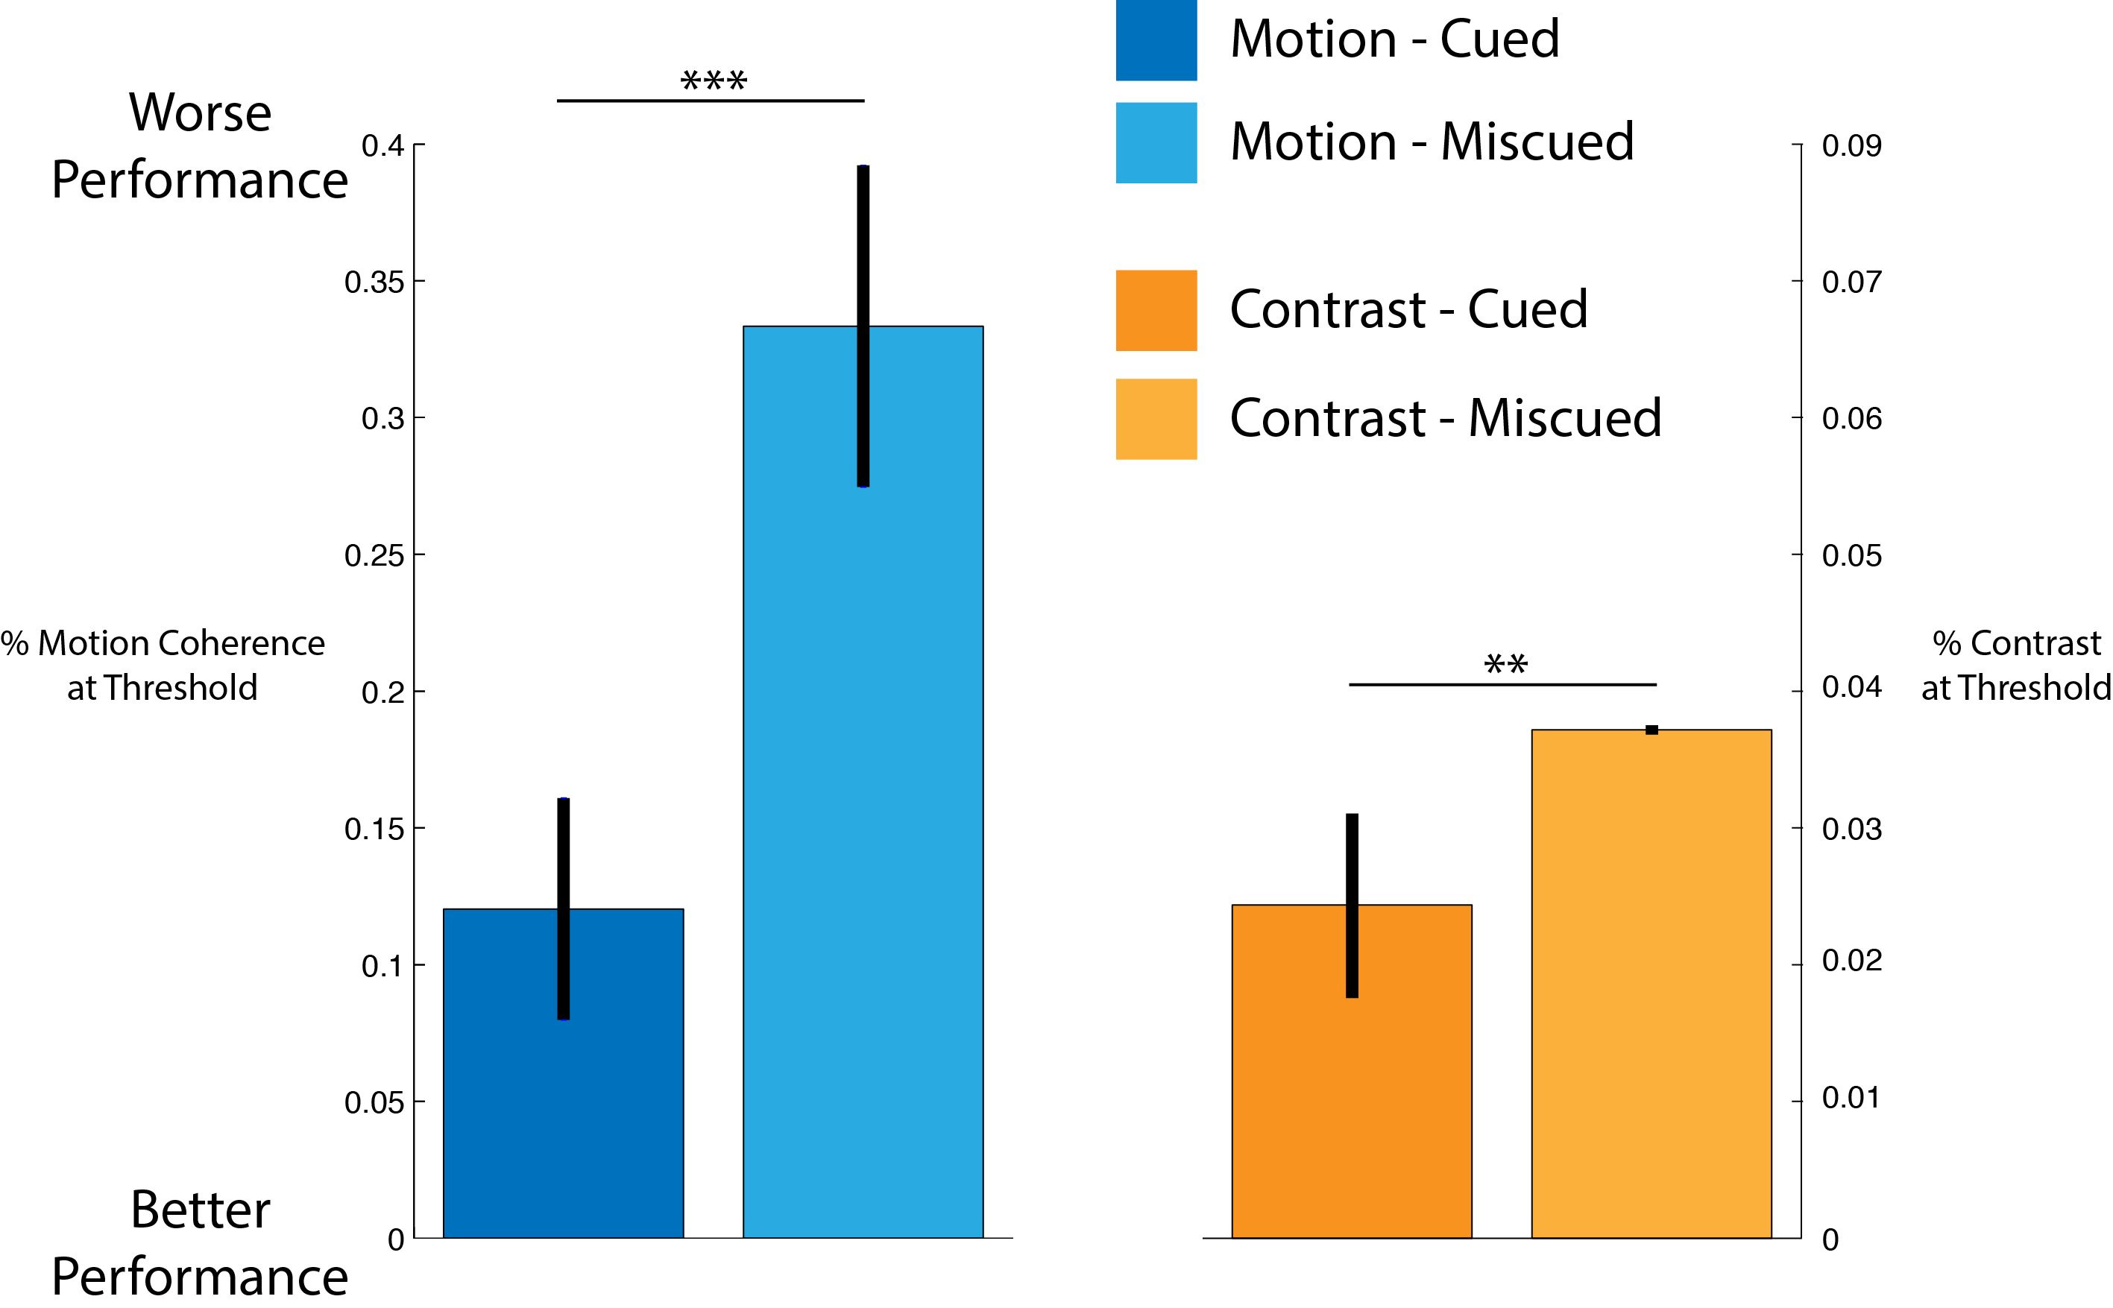
Notes:
Well, when you attend to motion and you respond about the motion you are quite good. It takes about a 10% increase in dots moving coherently to perceive that one side is consistently more intense than the other.

Slide 12
Notes:
But when you are miscued, so you paid attention to contrast but were asked about motion, it takes 3x as many dots moving coherently to get the same performance.

Slide 13
Notes:
Contrast behaves a bit differently, you need about a 2-3% difference in contrast to be successful,

Slide 14
Notes:
And that only increases slightly when you are miscued.
In a view of attention as a single process this data is a huge problem, to account for this asymmetry we would have to explain it away due to differences in the task. But I think we can do better.

Slide 15
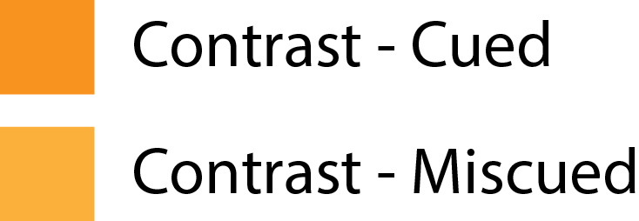
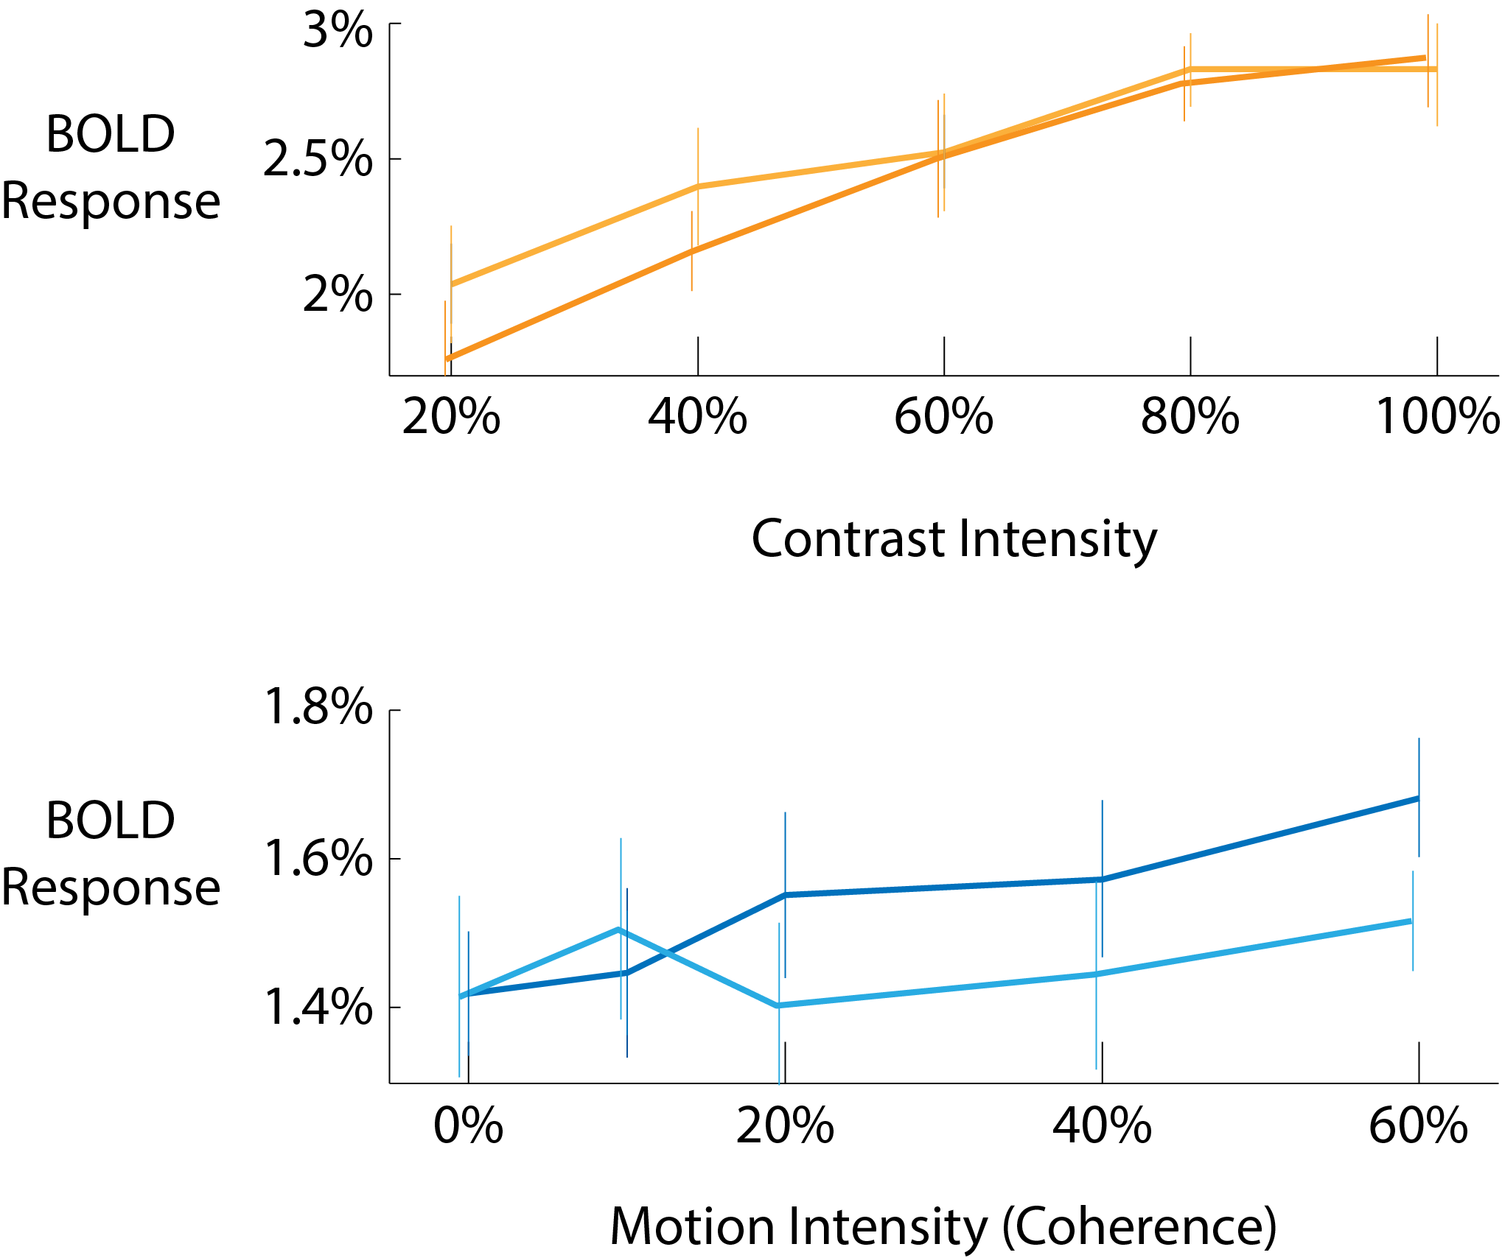

Notes:
In fact, when we look at the fMRI responses in areas V1 and MT we see a pattern that gives us a hint about why this might be happening. It looks like contrast is largely insensitive to attention, but that responses to motion vanish when your attention is focused on contrast. Why is that happening? We think it might be that attention to contrast corrupts or suppresses responses to motion, or that attention to motion is necessary for the brain to represent motion at all, and the next step is to find out if which model is true.

Slide 16
Is Attention necessary for Awareness?
Notes:
So to come back to the original question: Is attention necessary for awareness?

Slide 17
Is Attention necessary for Awareness?
It depends on the interaction of representations in the brain!
Notes:
The answer is—it depends! But we suspect that the answer can always be predicted from the anatomy and connectivity in the brain, and that attention is always specific to a feature.

Slide 18
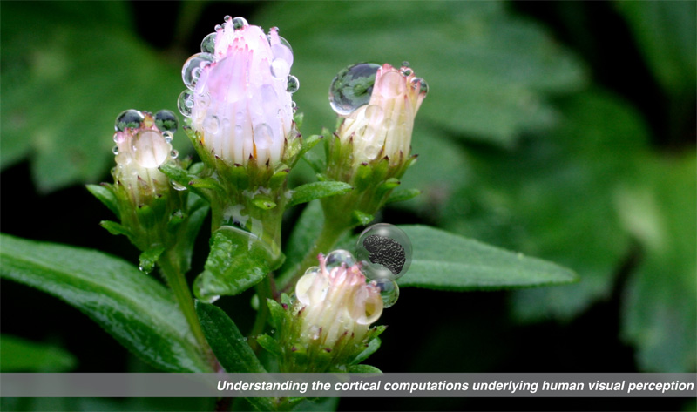

Gardner Lab @ Stanford University
Justin Gardner
Notes:
Thank you!

